Slide 1
Z-MAC: Hybrid MAC for Wireless Sensor Networks
Injong Rhee
Department of Computer Science
North Carolina State University
With the following collaborators:
Manesh Aia, Ajit Warrier, Jeongki Min

Slide 2
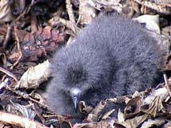
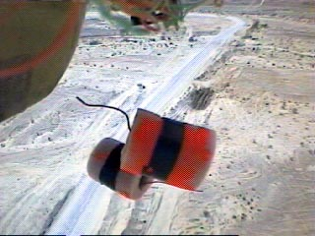
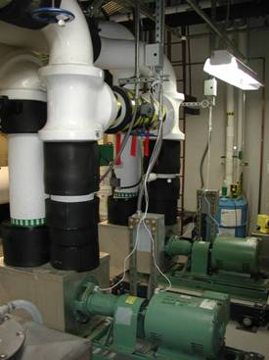
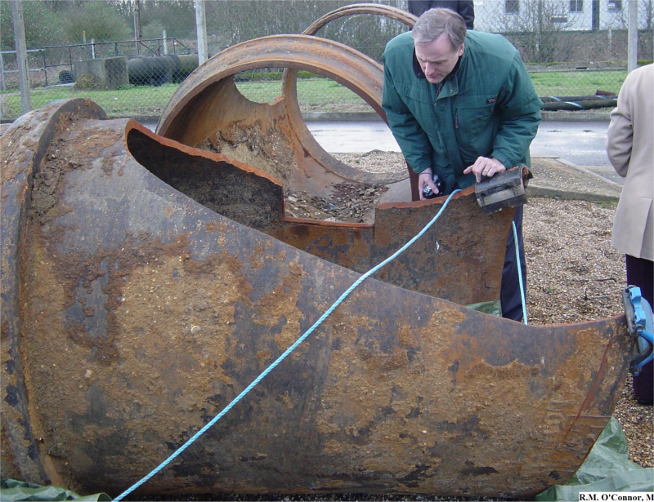
Introduction
  Basic goal of WSN – “Reliable data delivery consuming minimum power”.
  Diverse Applications
    Low to high data rate applications
    Low data rate
      Periodic wakeup, sense and sleep
    High data rate (10² to 10⁵ Hz sampling rate)
      In fact, many applications are high rate
      Industrial monitoring, civil infrastructure, medial monitoring, industrial process control, fabrication plants (e.g., Intel), structural health monitoring, fluid pipelining monitoring, and hydrology
Pictures by Wei Hong, Rory O’connor, Sam Madden

Slide 3
Diverse data rates within an application
Sink
E.g., Target tracking and monitoring
  Typically trigger multiple sensors in near vicinity
  Data aggregation near targets or the sink
  Some areas of the network could be highly contentious.

Slide 4
Sensor Network Research at NCSU
Energy efficient/Low overhead/High throughput MAC
  Approaches: Hybrid, TDMA+CSMA
Cross-layer optimization
  Congestion control, routing, MAC and power control.
Data Aggregation and Target Tracking
  Dynamic clustering and aggregation
Applications
  Wild animal tracking
  Red Wolf tracking (@Alligator River), Black Bear tracking (@Smokey Mountain).

Slide 5
Sensor MAC Requirements
High energy efficiency (High Throughput/energy Ratio)
High channel utilization (High throughput)
Low latency
Reliability
Scalability
Robustness and adaptability to changes
  Channel conditions (highly time varying)
  Sensor node failure (energy depletion, environmental changes)
  High clock drift

Slide 6
MAC Energy Usage
Four important sources of wasted energy in WSN:
  Idle Listening (required for all CSMA protocols)
  Overhearing (since RF is a broadcast medium)
  Collisions (Hidden Terminal Problem)
  Control Overhead (e.g. RTS/CTS or DATA/ACK)
Existing MAC Protocols (S-MAC, B-MAC)
Our work:
Z-MAC

Slide 7
Medium Access Paradigms
Contention Based (CSMA)
  Random-backoff and carrier-sensing
  Simple, no time synch, and robust to network changes
  High control overhead (for two-hop collision avoidance)
  High idle listening and overhearing overheads
    Solve this by duty cycling
TDMA Based (or Schedule based)
  Nodes within interference range transmit during different times, so collision free
  Requires time synch and not robust to changes.
  Low throughput and high latency even during low contention.
  Low idle listening and overhearing overheads
    Wake up and listen only during its neighbor transmission

Slide 8
Effective Throughput
CSMA vs. TDMA
IDEAL
CSMA
Sensitive to Time synch. errors,
Topology changes,
Slot assignment errors.
Channel Utilization
Do not use any topology or time synch. Info.
Thus, more robust to time synch. errors and changes.
TDMA
# of Contenders

Slide 9
Existing approaches
Hybird (CSMA + TDMA)
  SMAC by Ye, Heidemann and Estrin @ USC
    Duty cycled, but synchronized over macro time scales for neighbor communication
CSMA+Duty Cycle+LPL
  BMAC by Polastre, Hill and Culler @ UC Berkeley
    Duty cycled, but
    Low power listen - clever way reducing energy consumption (similar to aloha preamble sampling)

Slide 10
S-MAC – Design
Listen Period
  Sleep/Wake schedule synchronization with neighbors
  Receive packets from neighbors
Sleep Period
  Turn OFF radio
  Set timer to wake up later
Transmission
  Send packets only during listen period of intended receiver(s)
Collision Handling
  RTS/CTS/DATA/ACK

Slide 11
S-MAC – Design
Schedules can differ, prefer neighboring nodes to have same schedule
^{Node 1}
sleep
sleep
listen
listen
^{Node 2}
listen
sleep
listen
sleep
Border nodes may have to maintain more than one schedule.
^{Schedule 1}
^{Schedule 2}

Slide 12
  B-MAC: Basic Concepts
  Keep core MAC simple
  Provides basic CSMA access
  Optional link level ACK, no link level RTS/CTS
  CSMA backoffs configurable by higher layers
  Carrier sensing using Clear Channel Assessment (CCA)
  Sleep/Wake scheduling using Low Power Listening (LPL)

Slide 13
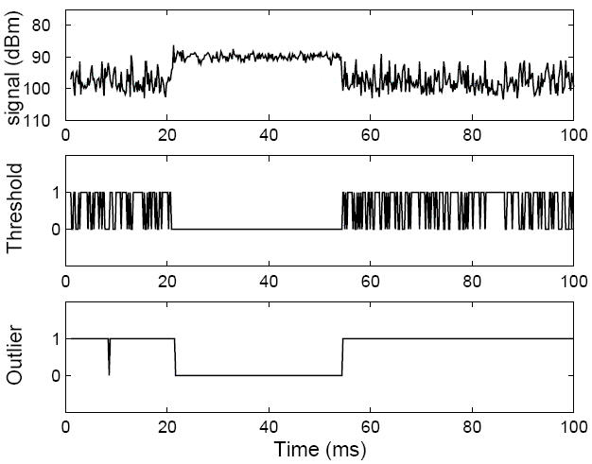
  Clear Channel Assessment
Before transmission – take a sample of the channel
If the sample is below the current noise floor, channel is clear, send immediately.
If five samples are taken, and no outlier found => channel busy, take a random backoff
Noise floor updated when channel is known to be clear e.g. just after packet transmission
A packet arrives between 22 and 54ms.
The middle graph shows the output of a thresholding CCA algorithm.
( 1: channel clear, 0: channel busy)

Slide 14
  Low Power Listening
Check
Interval
Carrier sense
Receiver
Receive data
Sender
Long Preamble
Data Tx
    Similar to ALOHA preamble sampling
    Wake up every Check-Interval
    Sample Channel using CCA
    If no activity, go back to sleep for Check-Interval
    Else start receiving packet
    Preamble > Check-Interval

Slide 15
  Low Power Listening
Check
Interval
Carrier sense
Receiver
Receive data
Sender
Long Preamble
Data Tx
    Longer Preamble => Longer Check Interval, nodes can sleep longer
    At the same time, message delays and chances of collision also increase
    Length of Check Interval configurable by higher layers

Slide 16
Z-MAC: Basic Idea - Can you do the contention resolution in Hybrid?
MAC
Channel Utilization
Low Contention
High Contention
CSMA
High
Low
TDMA
Low
High
Z-MAC – a Hybrid MAC protocol combines the strengths of both CSMA and TDMA at the same time offsetting their weaknesses.
Z-MAC uses a base TDMA schedule as a hint to schedule the transmissions of the nodes, and it differs from TDMA by allowing non-owners of slots to 'steal' the slot from owners if they are not transmitting.
High channel efficiency and fair (quality of service)

Slide 17
Effective Throughput
CSMA vs. TDMA
IDEAL
Channel Utilization
TDMA
CSMA
# of Contenders

Slide 18
Z-MAC: Basic components
Baseline - CSMA
Use Imprecise Topology and Timing Info in a robust way.
  Combining CSMA with TDMA
Scalable and Efficient TDMA scheduling

Slide 19
TDMA Scheduling
Two nodes in the interference range assigned to different time slots.
Owners and non-owners
E
A
2/7
C
D
3/7
B
1/7
F
Radio Interference Map
5/7
0
DRAND slot assignment
1
A
E
A
3
E
4/7
2
D
7/7
C
D
C
B
F
B
F
6/7
Input Graph
1
0
1
2
3
4
5
6
7
Time slice
Time period

Slide 20
Z-MAC Transmission Control
Busy
Owner Accessing Channel
Busy
Owner Accessing Channel
Random Backoff (Contention Window)
Busy
Non-owner Accessing Channel
To
Busy
Non-owner Accessing Channel
To
Random Backoff (Contention Window)

Slide 21
Z-MAC Transmission Control (Continued)
TDMA and Z-MAC under high contention (Two node example)
A
A
A
B
B
B
A
A
A
B
B
B
TDMA under no contention (Two node example)
A
A
A
A
A
A
Z-MAC under no contention (Two node example)
A
A
A
A
A
A
A
A
A
A
A
A

Slide 22
DRAND
    Z-MAC requires a conflict-free transmission schedule or a TDMA schedule.
    DRAND is a distributed TDMA scheduling scheme. Let G = (V, E) be an input graph, where V is the set of nodes and E the set of edges. An edge e = (u, v) exists if and only if u and v are within interference range. Given G, DRAND calculates a TDMA schedule in time linear to the maximum node degree in G.
    DRAND is fully distributed, and is the first scalable implementation of RAND, a famous centralized channel scheduling scheme.

Slide 23
DRAND – Algorithm
E
A
C
D
B
F
Radio Interference Map
0
1
E
A
E
A
2
3
C
D
C
D
B
F
B
F
1
DRAND slot assignment
0
Input Graph

Slide 24
DRAND – Algorithm – Successful Round
B
B
F
F
A
Request
A
Grant
C
E
C
E
G
D
G
D
Step I – Broadcast Request
Step II – Receive Grants
B
B
B
F
F
F
A
A
Release
A
C
C
C
E
Two Hop Release
E
E
G
G
D
G
D
D
Step III – Broadcast Release
Step IV – Broadcast Two Hop Release

Slide 25
DRAND – Algorithm – Unsuccessful Round
B
B
F
F
Grant
A
Request
Grant
A
Reject
C
E
C
E
G
D
G
D
Step I – Broadcast Request
Step II – Receive Grants from A,B,D but Reject from E
B
F
A
Fail
C
E
D
G
Step III – Broadcast Fail

Slide 26
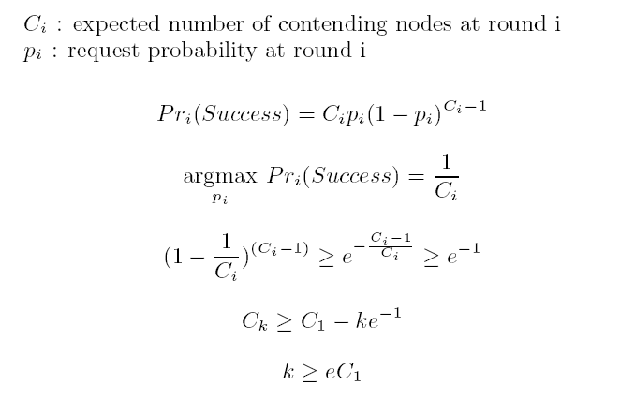
Simple Analysis (# of rounds)

Slide 27
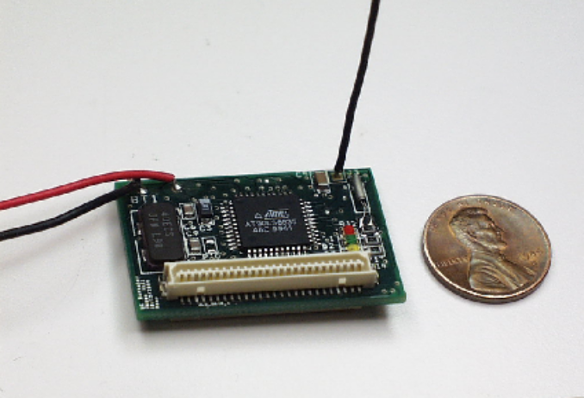
Performance Results
    DRAND and ZMAC have been implemented on both NS2 and on Mica2 motes (Software can be downloaded from: http://www.csc.ncsu.edu/faculty/rhee/export/zmac/index.html)
    Platform:
      Mica2
      8-bit CPU at 4MHz
      8KB flash, 256KB RAM
      916MHz radio
      TinyOS event-driven

Slide 28
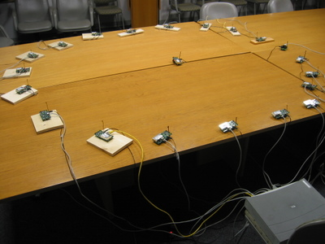
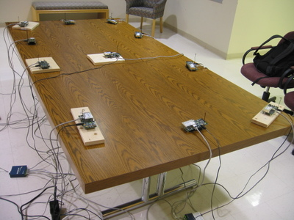
Experimental Setup – Single Hop
  Single-Hop Experiments:
    Mica2 motes equidistant from one node in the middle.
    All nodes within one-hop transmission range.
    Tests repeated 10 times and average/standard deviation errors reported.

Slide 29
Z-MAC – Two-Hop Experiments
    Setup – Two-Hop
      Dumbbell shaped topology
      Transmission power varied between low (50) and high (150) to get two-hop situations.
      Aim – See how Z-MAC works when Hidden Terminal Problem manifests itself.
Sink
Sources
Sources

Slide 30
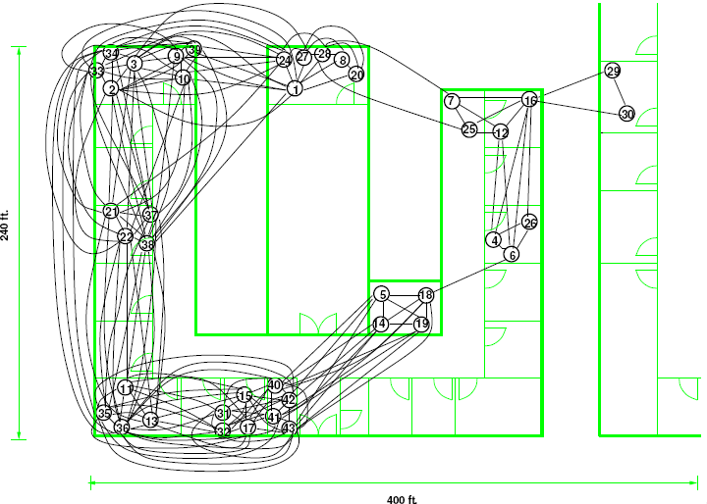
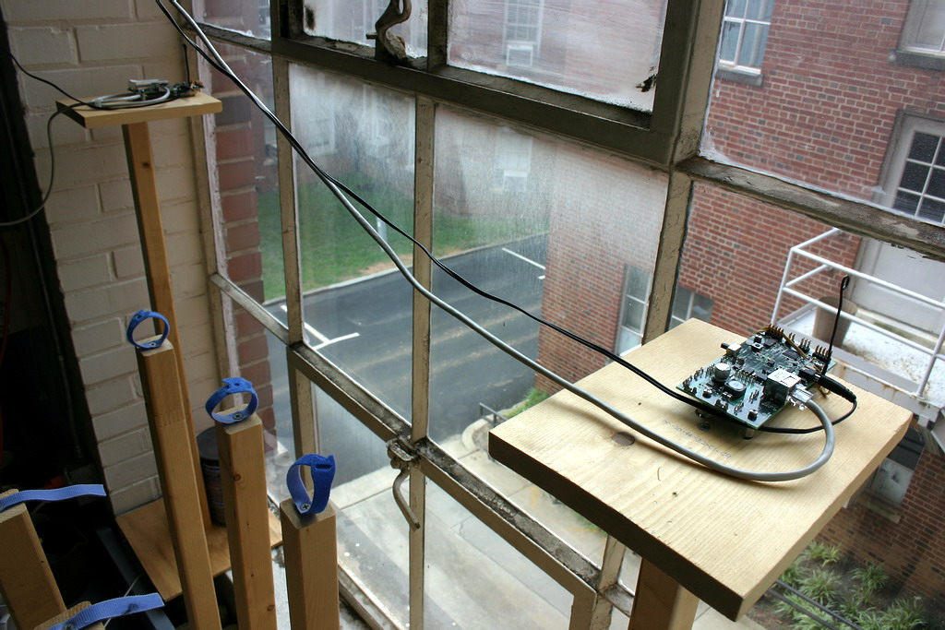
Experimental Setup - Testbed
  40 Mica2 sensor motes in Withers Lab.
  Wall-powered and connected to the Internet via Ethernet ports.
  Programs uploaded via the Internet, all mote interaction via wireless.
  Links vary in quality, some have loss rates up to 30-40%.
  Assymetric links also present (14-->15).

Slide 31
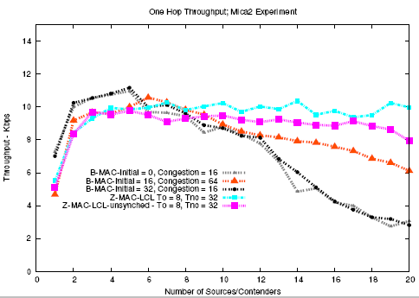
Z-MAC – Single-Hop Throughput
Z-MAC
B-MAC

Slide 32
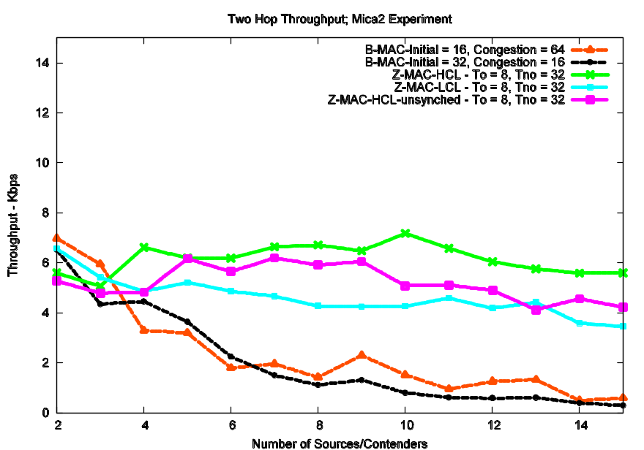
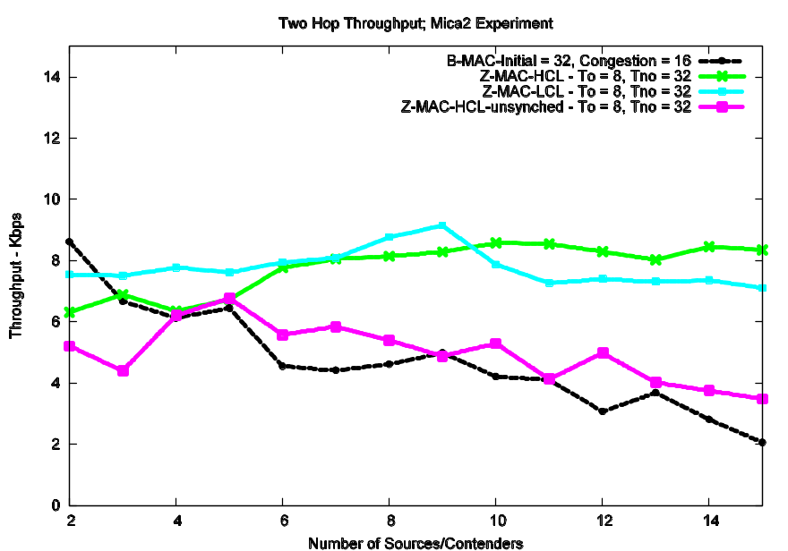
Z-MAC – Two-Hop Throughput
Z-MAC
Z-MAC
B-MAC
B-MAC
Low Power
High Power

Slide 33
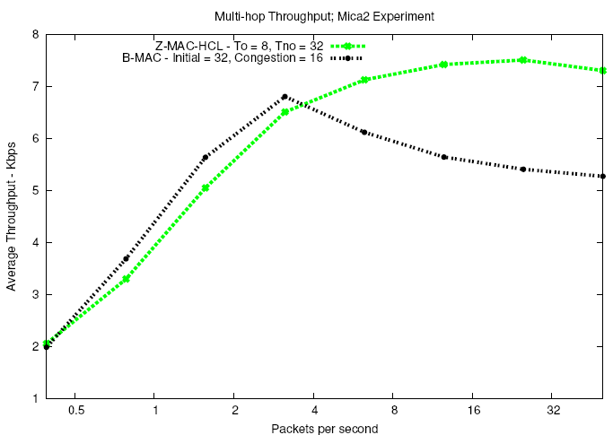
Multi Hop Results – Throughput
MULTI-HOP
Z-MAC
B-MAC

Slide 34
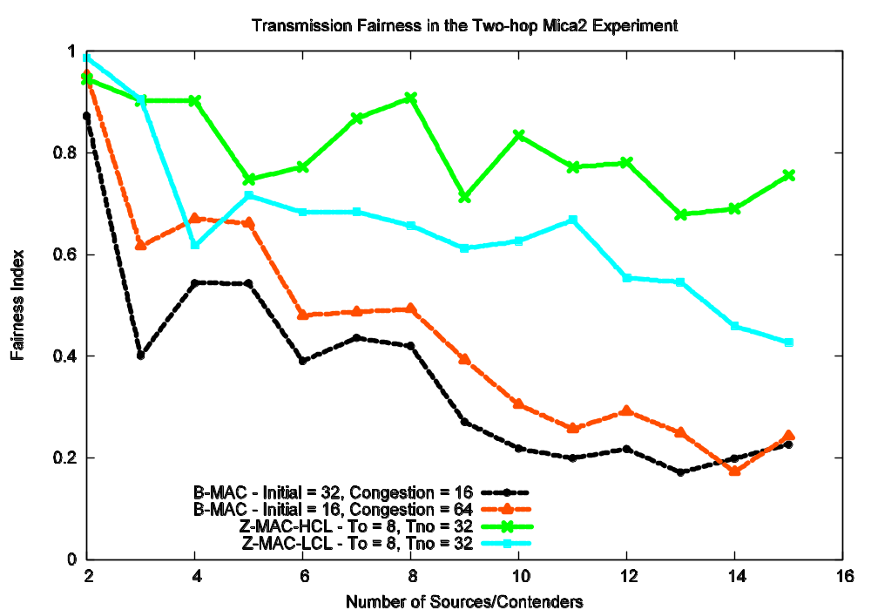
Fairness (two hop)

Slide 35
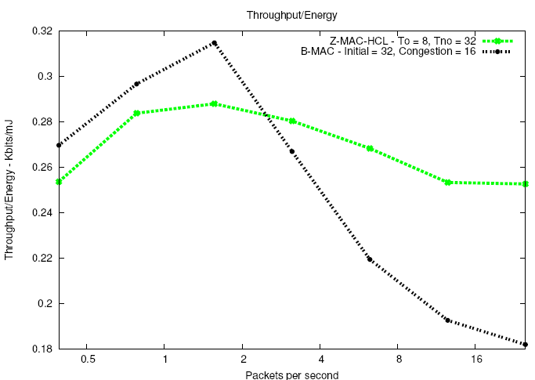
Multi Hop Results – Energy Efficiency (KBits/Joule)
Z-MAC HCL
B-MAC
MULTI-HOP

Slide 36
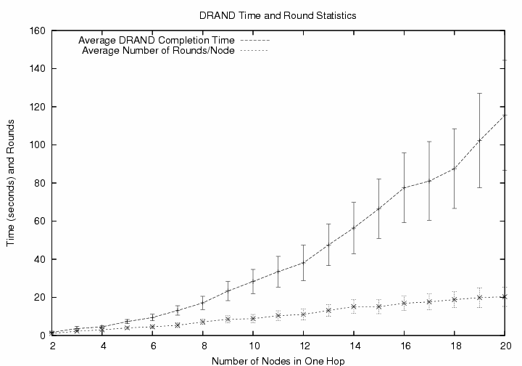
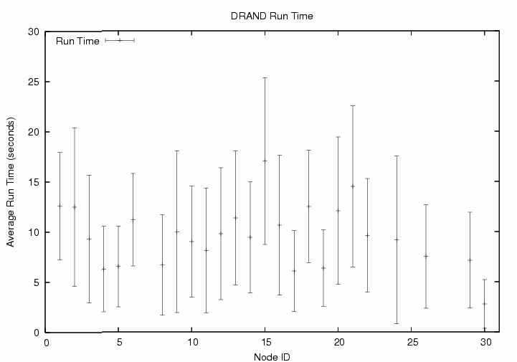
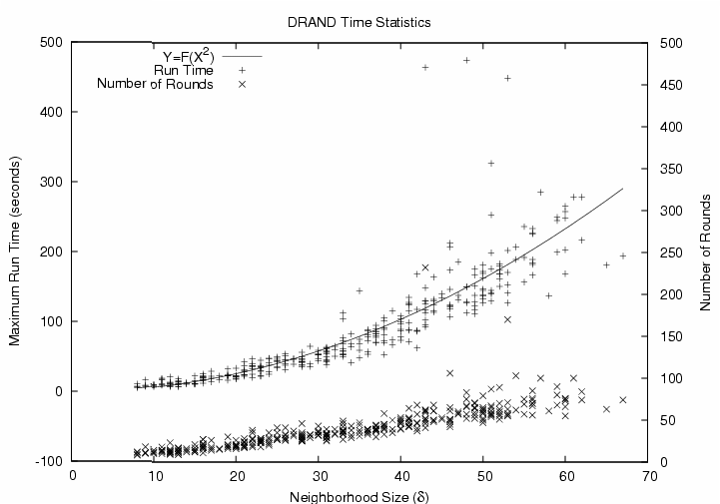
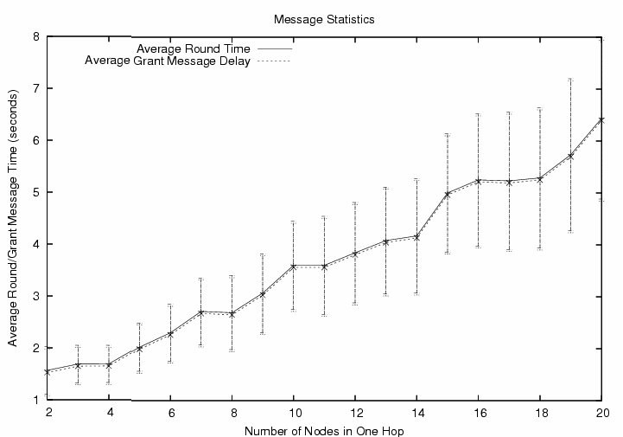
DRAND Performance Results – Run Time
Single-Hop
Multi-Hop (Testbed)
Multi-Hop (NS2)
Round Time – Single-Hop

Slide 37
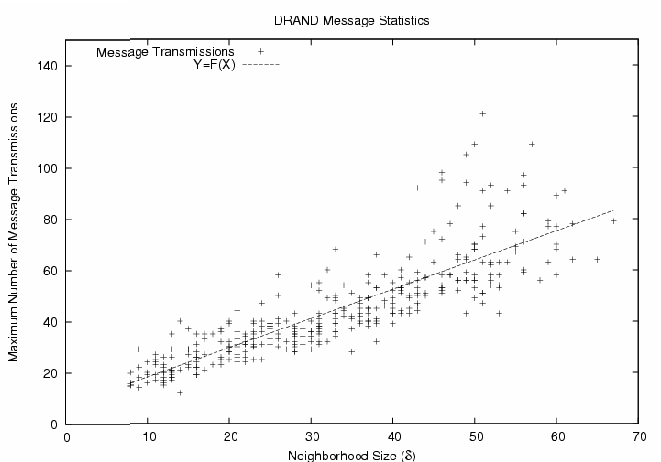
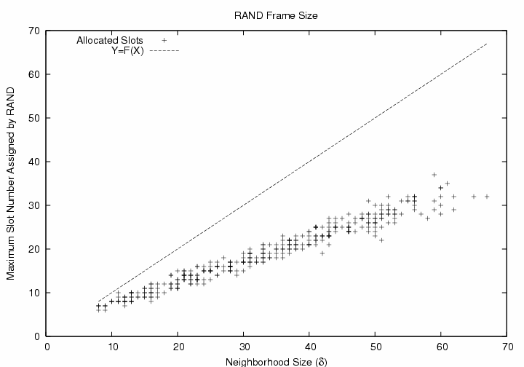
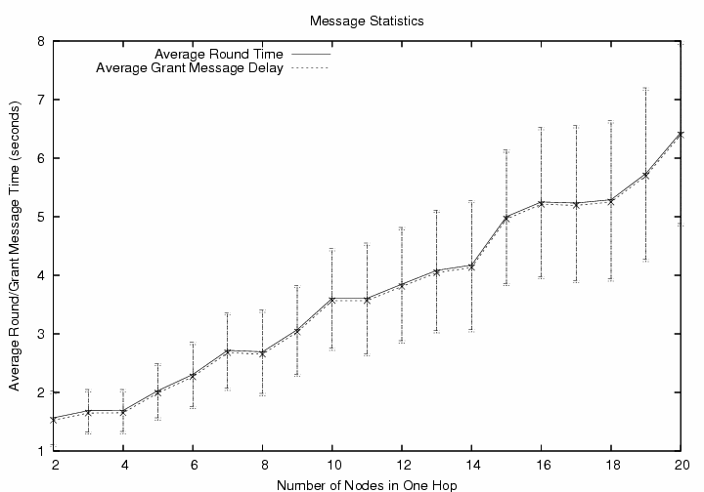
DRAND Performance Results – Message Count and Number of Slots
Multi-Hop (NS2)
Number of Slots Assigned – Multi-Hop (NS2)
Single Hop

Slide 38
Overhead (Hidden cost)
Operation | Average (J) | StdDev
Neighbor Discovery | 0.73 | 0.0018
DRAND | 4.88 | 3.105
Local Frame Exchange | 1.33 | 1.39
Time Synchronization | 0.28 | 0.036
Total energy: 7.22 J – 0.03% of typical battery (2500mAh, 3V)

Slide 39
Conclusion
Z-MAC combines the strength of TDMA and CSMA
  High throughput independent of contention.
  Robustness to timing and synchronization failures and radio interference from non-reachable neighbors.
    Always falls back to CSMA.
Compared to existing MAC
  It outperforms B-MAC under medium to high contention.
  Achieves high data rate with high energy efficiency.

Slide 40
Z-MAC
    Hybrid MAC for WSN
      Combine strengths of TDMA and CSMA.
      Uses the TDMA schedule created by DRAND as a 'hint' to schedule transmissions.
      The owner of a time-slot always has priority over the non-owners while accessing the medium.
      Unlike TDMA, non-owners can 'steal' the time-slot when the owners do not have data to send.
      This enables Z-MAC to switch between CSMA and TDMA depending on the level of contention.
      Hence, under low contention, Z-MAC acts like CSMA (i.e. high channel utilization and low latency), while under high contention, Z-MAC acts like TDMA (i.e. high channel utilization, fairness and low contention overhead).

Slide 41
Z-MAC – Local Frames
    After DRAND, each node needs to decide on frame size.
    Conventional wisdom – Synchronize with rest of the network on Maximum Slot Number (MSN) as the frame size.
    Disadvantage:
      MSN has to broadcasted across whole network.
      Unused slots if neighbourhood small, e.g. A and B would have to maintain frame size of 8, in spite of having small neighbourhood.
E
1(5)
F
3(5)
A
B
C
D
G
4(5)
0(2)
1(2)
2(5)
0(5)
Label is the assigned slot, number in parenthesis is maximum slot number within two hops
H
5(5)

Slide 42
Z-MAC – Local Frames
    Time Frame Rule (TF Rule)
      Let node i be assigned to slot s_{i}, according to DRAND and MSN within two hop neighbourhood be F_{i}, then i's time frame is set to be 2ª, where positive integer a is chosen to satisfy condition
        2^{a-1} <= F_{i} < 2ª – 1
      In other words, i uses the s_{i}-th slot in every 2ª time frame (i's slots are L * 2ª + s_{i}, for all L=1,2,3,...)

Slide 43
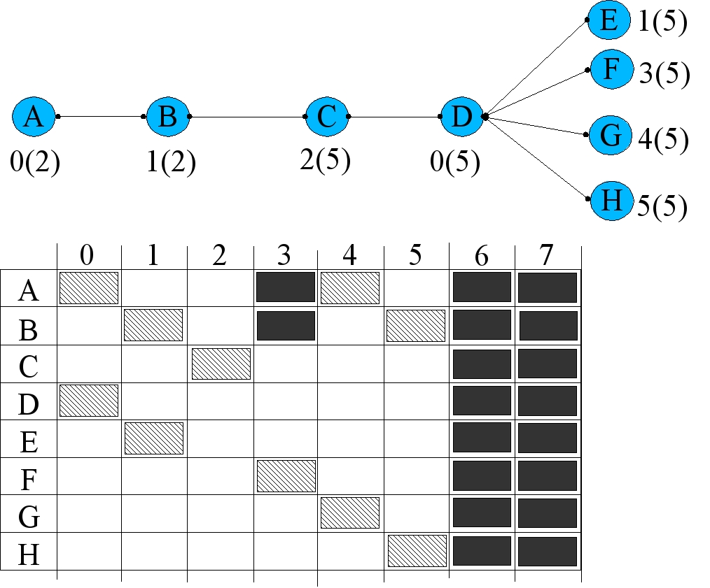
Z-MAC – Local Frames

Slide 44
Z-MAC – Transmission Control
    Slot Ownership
      If current timeslot is the node's assigned time-slot, then it is the Owner, and all other neighbouring nodes are Non-Owners.
    Low Contention Level – Nodes compete in all slots, albeit with different priorities. Before transmitting:
      if I am the Owner – take backoff = Random(To)
      else if I am Non-Owner – take backoff = To + Random(Tno)
      after backoff, sense channel, if busy repeat above, else send.
    Switches between CSMA and TDMA automatically depending on contention level
    Performance depends on specific values of To and Tno
    From analysis, we use To = 8 and Tno = 32 for best performance

Slide 45
Z-MAC – LCL
    Problem – Hidden Terminal Collisions
      Although LCL effectively reduces collisions within one hop, hidden terminal could still manifest itself when two hops are involved.
C
2(2)
0(2)
A
B
1(2)
Time Slots
0
1
2
0
A(0)
B(1)
Collision at C

Slide 46
Z-MAC – HCL
    High Contention Level
      If in HCL mode, node can compete in current slot only if:
        It is owner of the slot OR
        It is one-hop neighbour to the owner of the slot
C
2(2)
A
B
0(2)
1(2)
Time Slots
0
1
2
0
A(0)
B(1)
Slot in HCL, sleep till next time slot
Collisions still possible here

Slide 47
Z-MAC – Explicit Contention Notification
    ECN
      Informs all nodes within two-hop neighbourhood not to send during its time-slot.
      When a node receives ECN message, it sets its HCL flag.
      ECN is sent by a node if it experiences high contention.
      High contention detected by lost ACKs or congestion backoffs.
      On receiving one-hop ECN from i, forward two-hop ECN if it is on the routing path from i.
    ECN Suppression
      HCL flag is soft state, so reset periodically
      Nodes need to resend ECN if high contention persists.
      To prevent ECN implosion, if ECN message received from one-hop neighbour, cancel one's own pending ECN message.

Slide 48
Z-MAC – Explicit Contention Notification
    C experiences high contention
    C broadcasts one-hop ECN message to A, B, D.
    A, B not on routing path (C->D->F), so discard ECN.
    D on routing path, so it forwards ECN as two-hop ECN message to E, F.
    Now, E and F will not compete during C's slot as Non-Owners.
    A, B and D are eligible to compete during C's slot, albeit with lesser priority as Non-Owners.
Thick Line – Routing Path
Dotted Line – ECN Messages
F
forward
D
forward
C
E
A
B
discard
discard

Slide 49
Z-MAC – Performance Results
    Setup
      Single-hop, Two-hop and Multi-hop topology experiments on Mica2 motes.
      Comparisons with B-MAC, default MAC of Mica2, with different backoff window sizes.
      Metrics: Throughput, Energy, Latency, Fairness

Slide 50
Z-MAC – Performance Results – Throughput, Fairness
    Setup – Single-Hop
      20 Mica2 motes equidistant from a sink
      All nodes send as fast as they can – throughput, fairness measured at the sink.
      Before starting, made sure that all motes are within one-hop

Slide 51
Z-MAC – Energy Experiments
    Setup
      10 nodes within single cell sending to one sink
      Find optimum (lowest) energy to get a given throughput at the sink

Slide 52
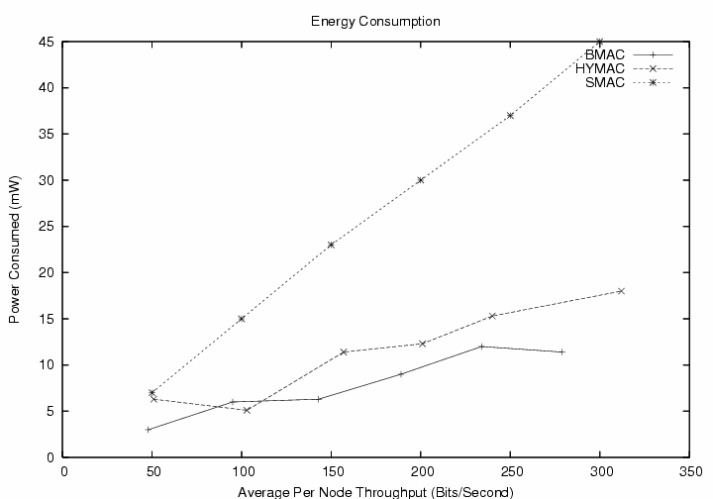
Z-MAC – Performance Results – Energy

Slide 53
Z-MAC – Latency Experiments
    Setup
      10 nodes in a chain topology.
      Source at one end transmits 100 byte packets at rate of 1 packet/10 s towards sink at the other end.
      Packet arrival time observed at each intermediate node, average per-hop latency calculated and then reported for different duty cycles.
Source
Sink

Slide 54
Multi Hop Results

Slide 55
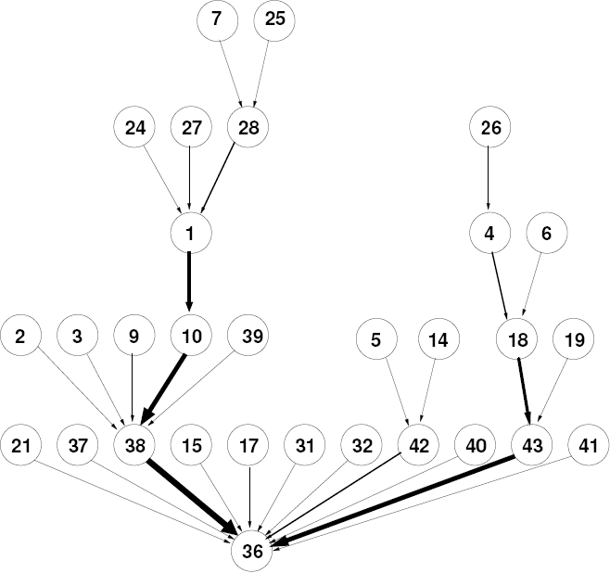
Multi Hop Results

Slide 56
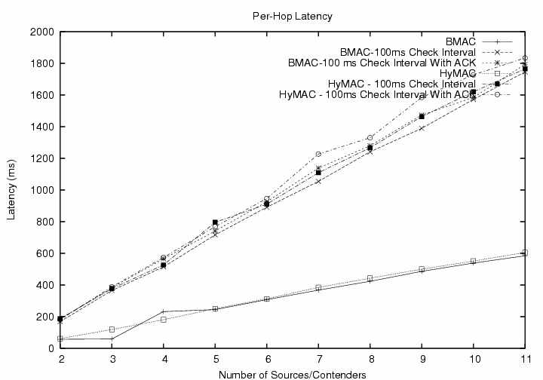
Z-MAC – Performance Results – Latency

Slide 57
Z-MAC – a Hybrid MAC for Wireless Sensor Networks
Q & A
Thank you for your participation

Slide 58
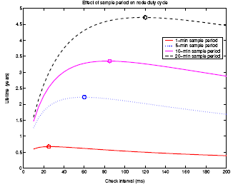
  LPL – Check Interval
    Too small
      Energy wasted on Idle Listening
    Too large
      Energy wasted on packet transmission (large preamble)
    In general, longer check interval is better.

